Slide 1
Data Science: Big Data Management Systems & Tools
Module 1: Reliable & Scalable Data-Intensive Applications

Slide 2
Welcome!
Introductions - Melissa
Course Objectives
Understand the architecture of reliable Big Data systems.
Describe how they differ from the traditional system.
Use several NoSQL database management systems.
Address the many challenges of working with data at scale.
Use tools such as MongoDB and Spark to process large datasets.
Apply MLOps and cloud-based analytics.
Course Logistics
Weekly Webinars
Discussion Board
11 Modules
4 Assignments + Final Project
Note: Assignments 3 & 4 may have possible amendments for additional tools to be supported (TBC)
Notes:
Note:

Slide 3
Welcome!
Hands-On Tools
Assignment 1: SQL and SQLite
Assignment 2: MongoDB + Pymongo
Assignments 3 & 4: Spark
Final Group Project: up to you!
Notes:
Note:

Slide 4
Module 1 Summary
Make applications that satisfy the needs of today’s users
Learning Outcomes
Identify the issues of scaling to Big Data
Describe Reactive Design as a framework for high-quality data-intensive systems
Discuss the impact of latency on user experience
Contrast and recognize the importance of asynchrony and parallelism, and
Explain strategies for highly reliable systems

Slide 5



We live in a 24 x 7 x 365 world
Users expect rich data sets, that are responsive, AND highly available, AND continuously improving, AND multi-platform applications
This is not a simple because:
Network links & servers get congested, or go down
Programming errors cause sudden loss or flood of data
Subservices could go down or take a long time to respond
The load can increase suddenly/dramatically from users
BUT users expect these issues to be handled seamlessly
Accomplishing this requires a fundamentally different way of building systems

Slide 6
Possible solution with Reactive Design
We can summarize the issues from the last slide into, large data, lots of users and high expectation
A common solution to this is an application with a Reactive Design framework
Reactive Design has four pillars
Responsive: should always provide continual feedback
Elasticity : system should stay responsive under varying workload (scalable)
Resilience: system should stay responsive even when failures occur
Message-Driven: the architecture used to implement the above

Slide 7
Strategies for highly reliable systems
Responsiveness
Decouple responsibility (Microservices)
Develop pieces at own pace & Continuous Delivery
Resilience
Use Test-Driven Design (TDD) to create better code
Replicate data for redundancy
Compartmentalize/decouple software
Message-driven
Green thread (manage parallel processing within application)
Actors ( message passing between threads in addition to being non-blocking and asynchronous)
Elasticity
Scalable
Parallelism (Distributed)
Notes:
Don’t put all of your eggs in one basket!
Distribute: Distribute data, datacenters regionally (can have a data center in America and in Europe! If one centre goes down, switch to using the other
Compartmentalize/decouple software: if one component of the software goes down, it doesn’t affect the others
Share-nothing architecture (microservices): have clear boundaries between systems and have protocols to allow them to communicate

Slide 8


Users want low latency
One key part of our expectations is low latency ( time between when we interact with a system and when the system responds to us)
At internet scale even the speed of light becomes a limiting factor
On a personal level, this can leave the user feeling a loss of control
On a professional level, this can cost companies a lot of money in churn

Slide 9
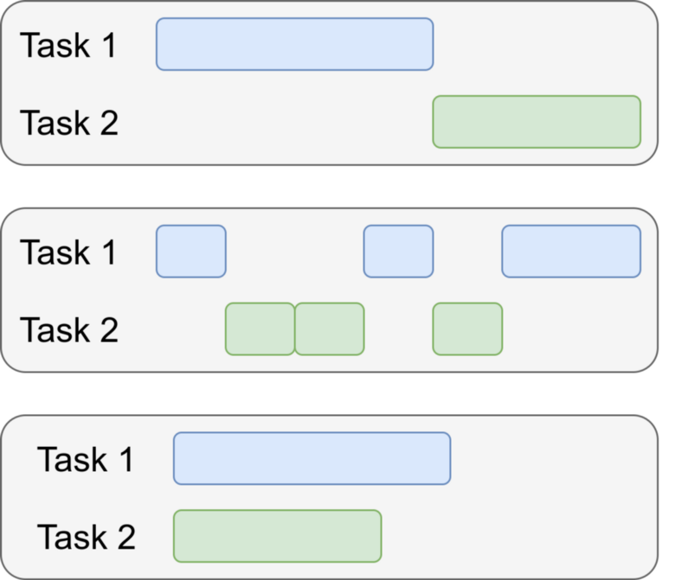
Reducing latency with async and parallelism
The best way to reduce latency is to avoid blocking when waiting for something whenever possible
In order to do this, we can employ the following:
Asynchronous - A system in which there is no central, coordinating clock. Execution of blocks of code occur in response to events
Parallelism - A system in which two or more processes are actually executing simultaneously on different CPUs
Sync
Async
Parallel

Slide 10
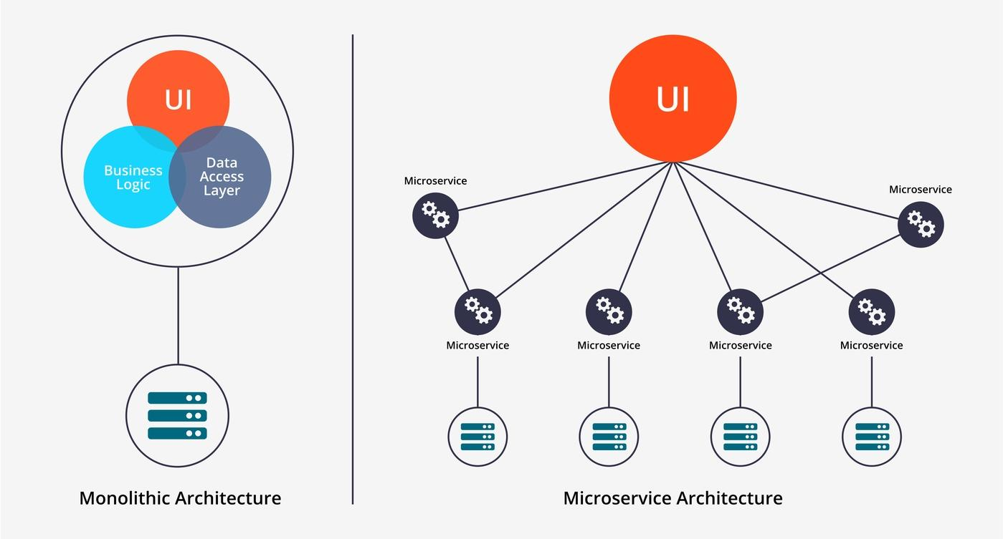
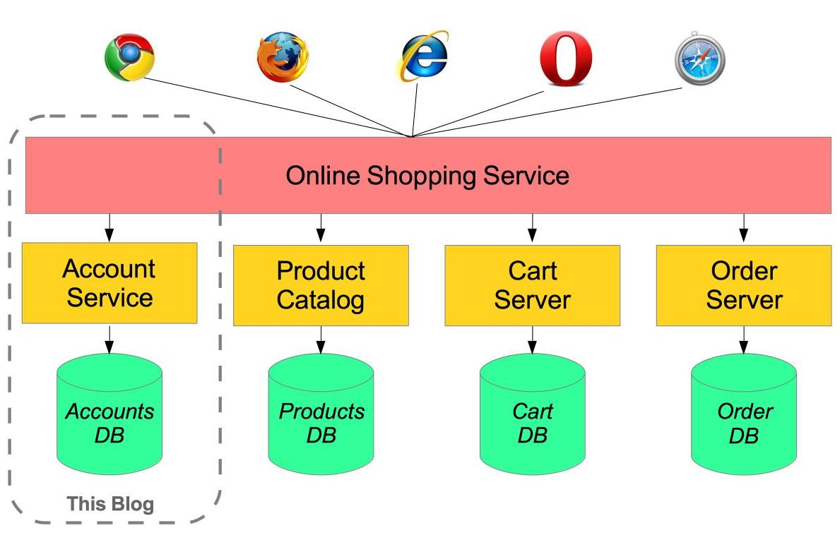
Microservices
Microservices fit well with reactive design
Microservices are single purpose applications that can be combined together to build a larger application
Each independent service communicates with the others through requests and responses
Source: https://www.weave.works/blog/what-are-microservices/
Source: https://spring.io/blog/2015/07/14/microservices-with-spring

Slide 11


Why is this important?
We build applications for users, and if the users are not happy they will not use the application
User expectations will continue to change and designer will need to continuously adapt to meet them

